Slide 1

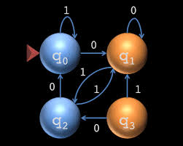
CS313 –theory of automata
Lecture 6 Chapter 5: Deterministic finite automata – DFA, Regular Languages
Week 2
Asst. Prof. Syed Faisal Ali
sfaisal@uit.edu
Computer Science E & F
SPRING 2025

Slide 2
Deterministic Finite Automaton (DFA)
Input Tape
String
Output
“Accept”
or
“Reject”
Logic using Finite
Automaton

Slide 3
Transition Graph
Initial state
transition
Accepting state
state

Slide 4
Alphabet
∑ = { a, b }
For every state, there is a transition
for every symbol in the alphabet

Slide 5
Initial Configuration
head
Input Tape
Input String
Initial state

Slide 6
Scanning the Input

Slide 7
Processing

Slide 8
processing

Slide 9
Accepted string - processing
Input finished
Accept
Last state determines the outcome

Slide 10
A Rejection Case
Input String

Slide 11
A Rejection Case - processing

Slide 12
A Rejection Case - processing

Slide 13
A Rejection Case - processing
Input finished
reject
Last state determines the outcome

Slide 14
Another Rejection Case
Tape is empty
Input Finished (no symbol read)
reject

Slide 15
This automaton accepts only one string
Language Accepted:

Slide 16
Decision on Accept / reject string
To accept a string:
To reject a string:
all the input string is scanned
and the last state is accepting
all the input string is scanned
and the last state is non-accepting

Slide 17
Another Example
Accept State 1
Accept State 2
Accept State 2

Slide 18
Another example
Empty Tape
Input Finished
Accept

Slide 19
Another Example
Accept State
trap state

Slide 20
Input String

Slide 23
Input finished
accept

Slide 24
A rejection case
Input String

Slide 27
Input finished
Reject

Slide 28
Language Accepted:

Slide 29
Another Example
Alphabet:
Language Accepted:

Slide 30
Formal Definition
: set of states
Deterministic Finite Automaton (DFA)
: input alphabet
: transition function
: initial state
: set of accepting states

Slide 31
Set of States
Example

Slide 32
Input Alphabet
:the input alphabet never contains
Example

Slide 33
Initial State
Example

Slide 34
Set of Accepting States
Example

Slide 35
Transition Function
Describes the result of a transition
from state with symbol

Slide 36
Example:

Slide 39
Transition Table for
symbols
states

Slide 40
Extended Transition Function
Describes the resulting state
after scanning string from state

Slide 41
Example:

Slide 44
Special case:
for any state

Slide 45
In general:
implies that there is a walk of transitions
states may be repeated

Slide 46
Language Accepted by DFA
Language accepted by DFA :
it is denoted as and contains
all the strings accepted by
We also say that recognizes

Slide 47
For a DFA
Language accepted by :

Slide 48
Language rejected by :

Slide 49
More DFA Examples
Empty language
All strings

Slide 50
Language of the empty string

Slide 51
= { all strings with prefix }
Accept

Slide 52
Another Example
= { all binary strings containing
substring }

Slide 53
= { all binary strings without
substring }

Slide 55
Regular Languages
Definition:
A language is regular if there is
a DFA M that accepts it ( )
The languages accepted by all DFAs
form the family of regular languages

Slide 56
Example Regular Languages:
{ all strings in {a,b}* with prefix }
{ all binary strings without substring }
There exist DFAs that accept these
languages (see previous slides).

Slide 57
There exist languages which are not Regular:
There are no DFAs that accept these languages
(we will prove this in a later class)

Slide 58
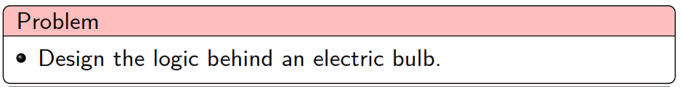
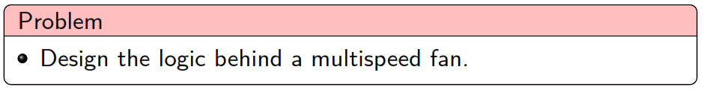
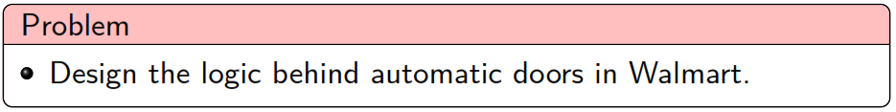

Slide 59
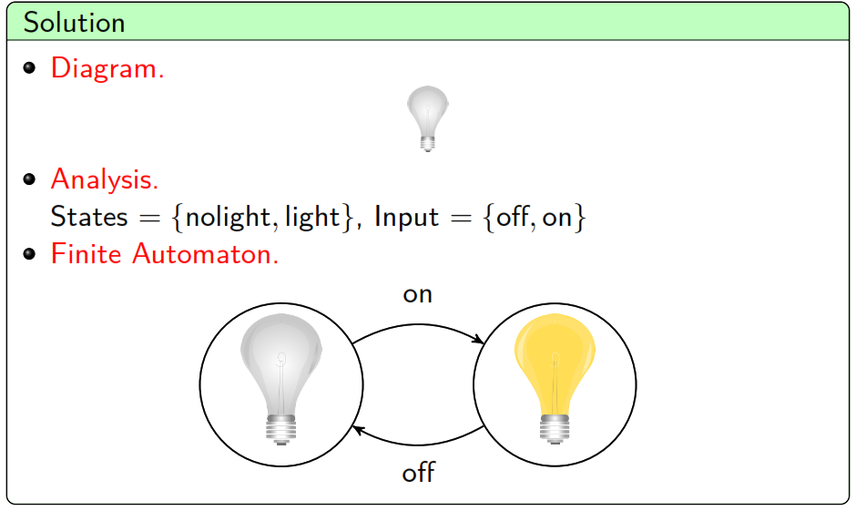

Slide 60
End of lecture

